Slide 1
CONTROL CONDITION

Slide 2
Question 1

Slide 3
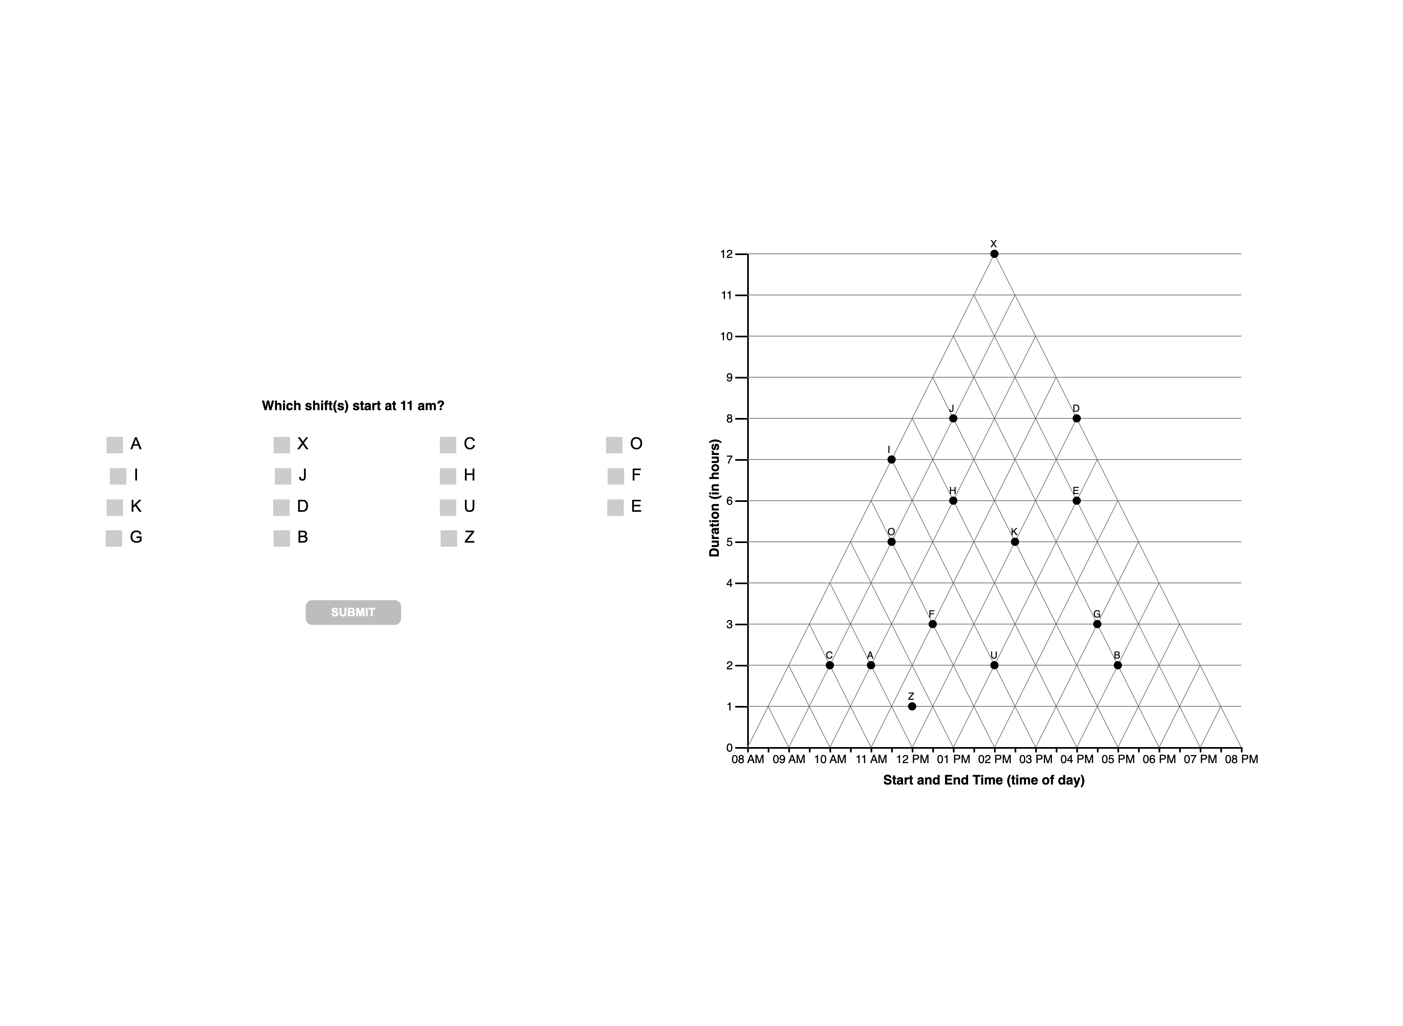

Slide 6
Question 2

Slide 7
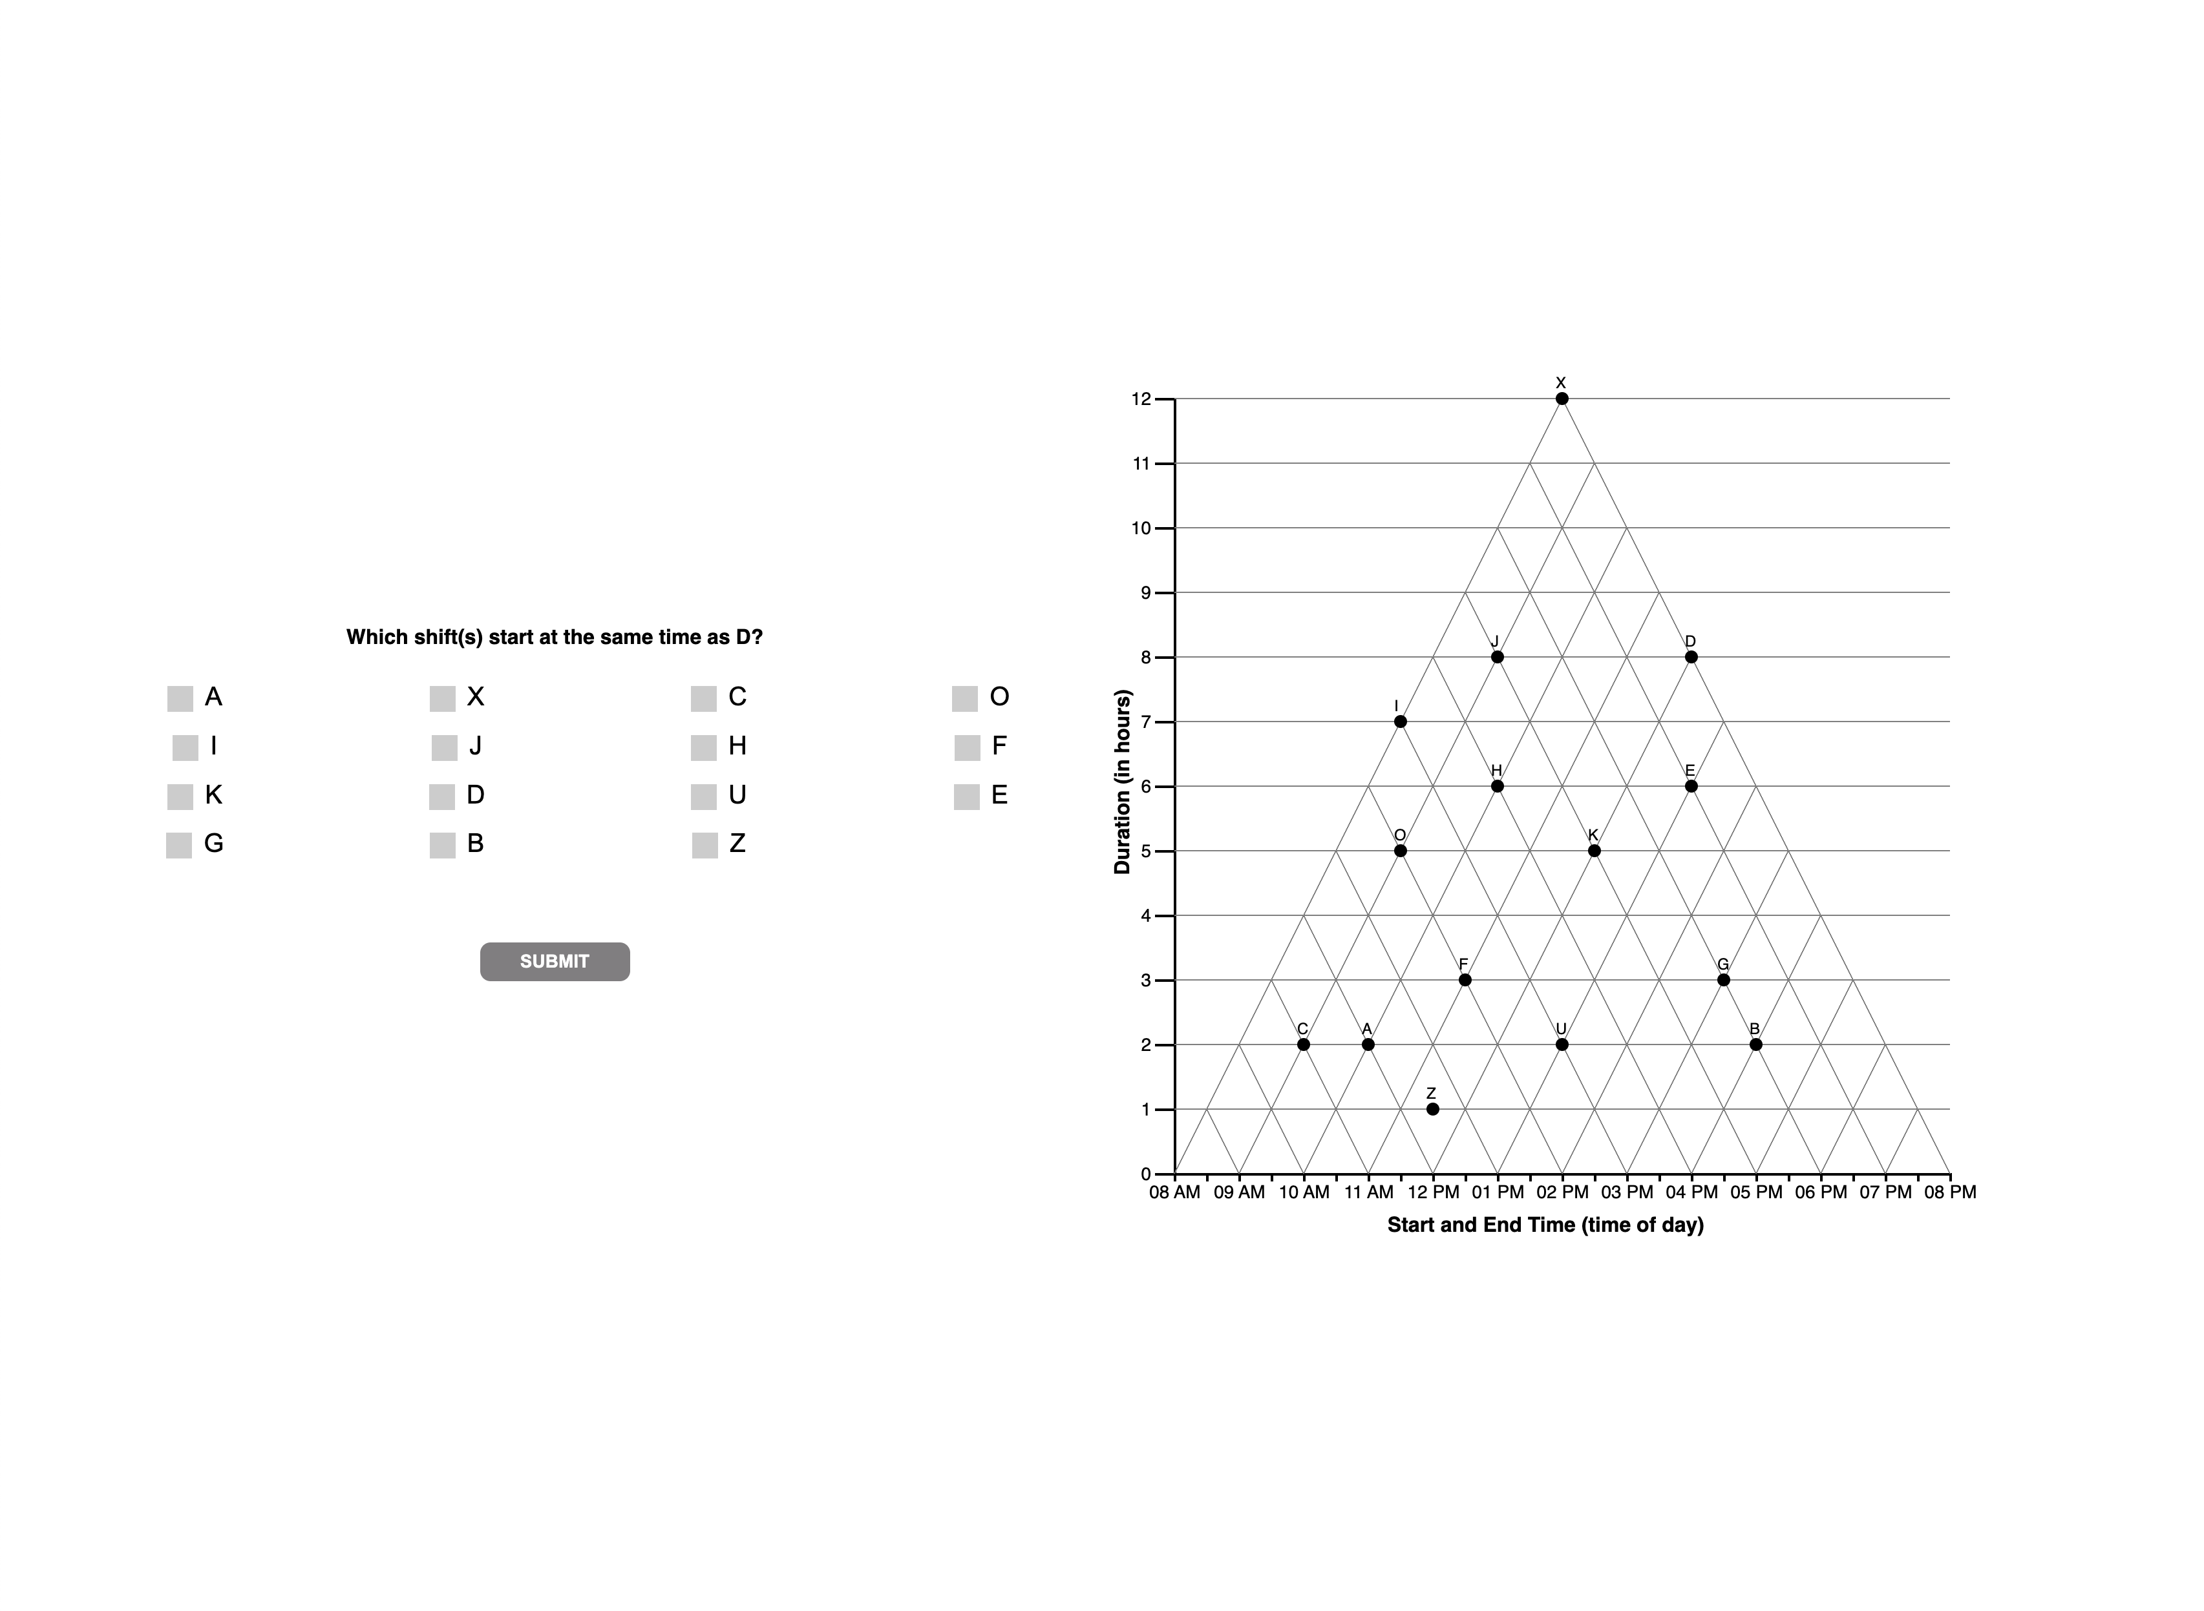

Slide 10
Question 3

Slide 11


Slide 13
Question 4

Slide 14


Slide 16
Question 5

Slide 17
